Slide 1
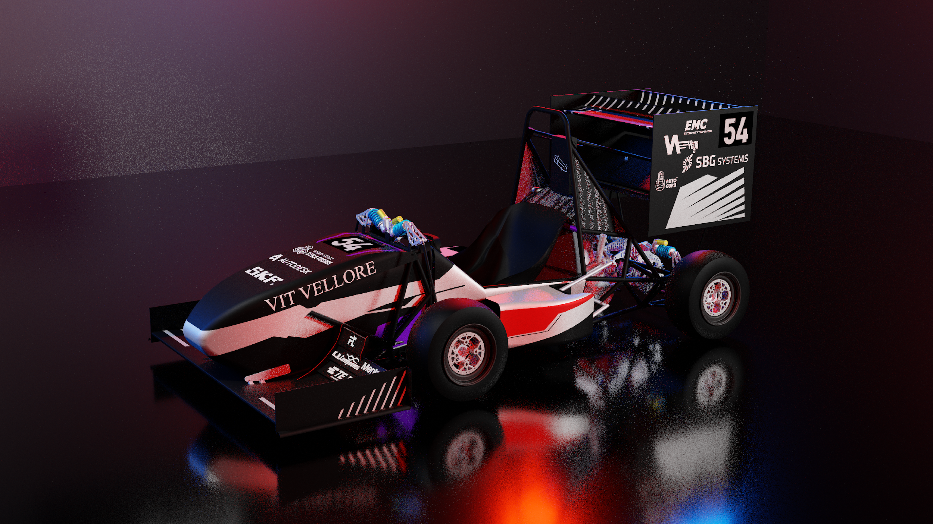


Trading
PAINT
Vellore Institute of Technology | #13

Slide 2

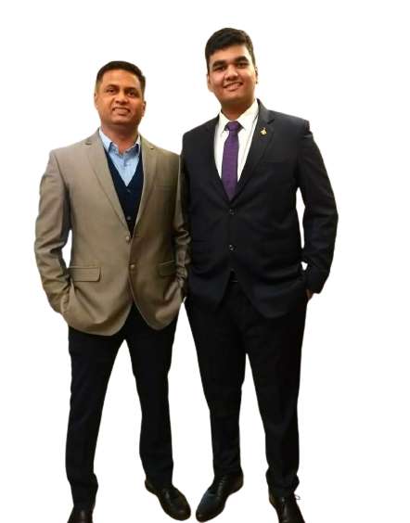

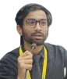
About Us
Trading Paint’s primary objective has been to help racers gain necessary experience before they embark on their journey to the big stage.
We have organized several race events locally which helped racers develop the necessary expertise to be able to compete at a global level. We have been able to connect promising talent to influencers who promote them at international events.
We have been thriving in the motorsport business and we are now combining motorsport with entertainment under this brand-new revamped program.
MEDIA AND PROMOTION PARTNERS
Leading platforms have already exhibited significant interest in Trading Paint:
The TV show will be exclusively featured on Amazon Prime Video
The show will be produced by Box-to-Box Films
Drivers shall get an affiliation to British Racing Drivers Club (BRDC) providing them higher exposure and recognition
Aneesh S
Founder
Krutin K
CEO
Aryan S
CFO
INTRODUCTION – BUSINESS IDEA – LOCATION – INVESTMENT – DEMOGRAPHIC – MARKETING STRATEGIES – COMPETITOR ANALYSIS – FINANCE

Slide 3





BUSINESS IDEA
Trading Paint is a whole new reality show based around our latest prototype PRV21. An action and drama-packed show that consists of 9 race weeks with an fascinating view through a 10 episode show on Amazon Prime Video.
The events will have a live audience cheering for their favourite celebrities on track while enjoying all race day activities. The live event will take place at three different historic locations in the UK which are in close proximity to densely populated areas.
The participants will take part in different race formats and battle it out against one another in their categories for the victory. The cars will have identical performance, making driver skill and consistency key for winning the championship.
The championship will be based on a points system and the driver with most points in their respective category at the end of the season will win while the team with most points will win the teams’ championship. The winning pro class driver will get to drive for BRDC Formula 3 in the forthcoming season.
INTRODUCTION – BUSINESS IDEA – LOCATION – INVESTMENT – DEMOGRAPHIC – MARKETING STRATEGIES – COMPETITOR ANALYSIS – FINANCE

Slide 4








Driver Structure & challenges
16 Drivers 2 Classes 4 Teams 9 Race Days and an Action Packed Season!
The Grid will be made up of drivers from various backgrounds, ranging from drivers with 10+ years of experience to minimal experience, where they will be divided into two classes:- Pro Class and Am Class. There will be 4 teams comprising 1 Mentor and 4 Drivers. The drivers will compete within their class for the victory throughout a 9 Race week Season.
Mentor :- These are veteran drivers will provide the drivers with insights on improving their race craft and consistency. They will be drivers who have been immensely successful in Formula racing like Jenson Button and Damon Hill
Challenges
Head to Head
Am Class:- These are the influencers, such as famous Youtubers who have a huge social media following among the youth across the globe like Supercar Blondie, Alex Kersten Shmee, Chris Harris etc.
Endurance
Pace Master
Pro Class:- These are the upcoming professional drivers, handpicked from junior formula categories in the UK in affiliation with British Racing Drivers Club.
Drag Strip
INTRODUCTION – BUSINESS IDEA – LOCATION – INVESTMENT – DEMOGRAPHIC – MARKETING STRATEGIES – COMPETITOR ANALYSIS – FINANCE
Notes:
Think

Slide 5


Season Format
Manufacturing
The show
Episodes release on amazon
Extensive R&D
2.5 months of vehicle manufacturing
10 weeks of exciting races
10 episodes released every week
Episode 1
Introduction, Driver Camp, Backstory, Rivalries
The season pilot will give an insight into the backstory of all drivers along with an interesting view into the driver camp, where the drivers will be selected by their mentors. At the same time the season format will be explained to the viewers for better understanding about the upcoming episodes.
Episode 2-9
Race Day Activities And Behind the scenes
Both the aspects of the event - on track and off track, for each race week will be covered in these episodes. Dynamics between the Pro, Am and their Mentors will be documented into a 45 min episode concluding with the race day action and results.
Episode 10
Conclusion & Sneak peak into next year
The season conclusion will be made into a single 60 min episode which will put an end to all driver battles and storylines that appear during the two-and-a-half month season. It will also include a few teasers about next season to keep the fans engaged.
INTRODUCTION – BUSINESS IDEA – LOCATION – INVESTMENT – DEMOGRAPHIC – MARKETING STRATEGIES – COMPETITOR ANALYSIS – FINANCE
Notes:
Add the png
horizontal

Slide 6

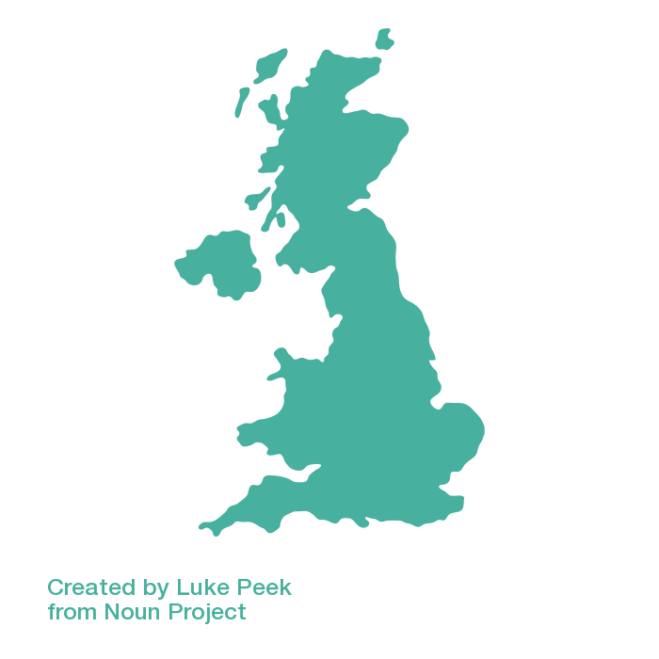





Why UK
Tracks and Proximity
UK is home to a lot of historic tracks
All Tracks are within 3 hours of Production Facility
Closeness to Urban cities like London will help boost Ticket Sales
Influencer Following
UK has an abundance of Influencers with Millions of followers
66% of total Population or 45M people use Social Media in UK
Higher Social Media Engagement than most Countries
Motorsports Enthusiasts
13M formula racing enthusiasts are present in England
350k people visited British Grand Prix in 2019
It is rapidly growing audience among UK Youth
Manufacturing
£3B investment is made in the Automotive sector every year
£15.3B value is added to the UK economy every year
Closeness to the motorsports industry belt will reduce logistic costs
Headquarters in London
INTRODUCTION – BUSINESS IDEA – LOCATION – INVESTMENT – DEMOGRAPHIC – MARKETING STRATEGIES – COMPETITOR ANALYSIS – FINANCE

Slide 7





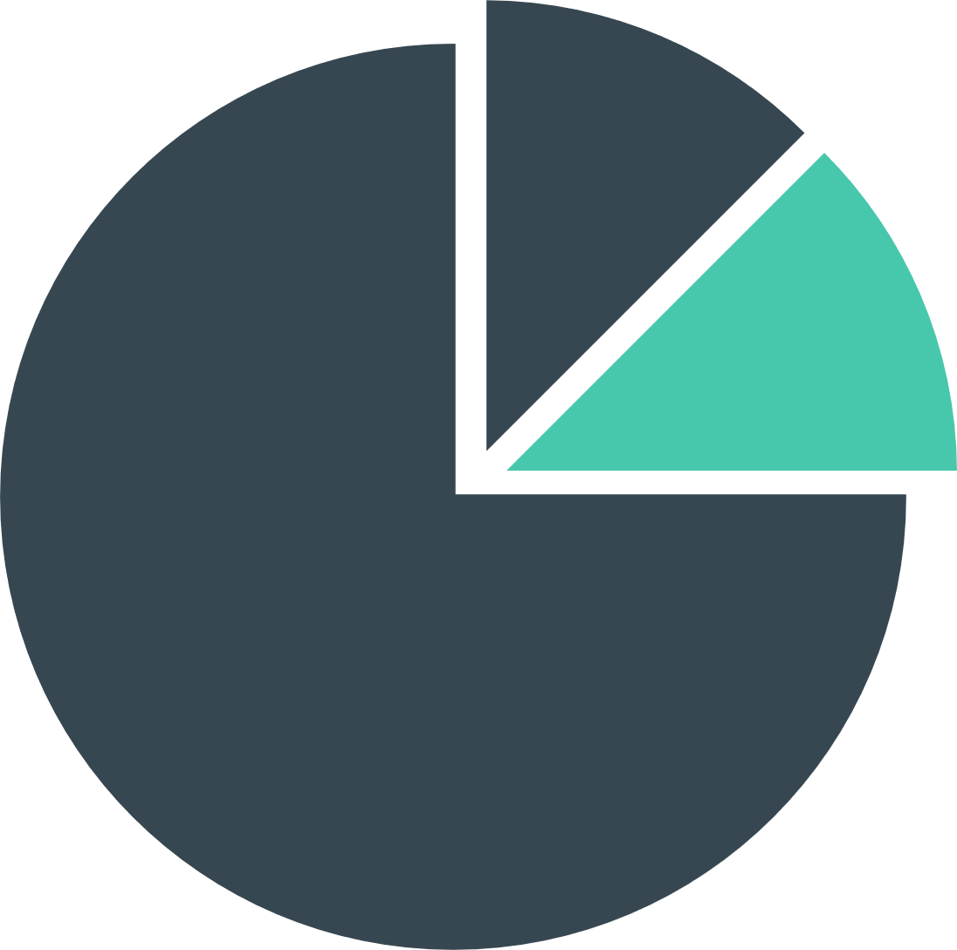


Investment breakdown
£
3.5M
HEADQUARTERS AND
PRODUCTION FACILITY
33%
INVESTMENT
TRACK AND LOGISTICS
30%
30%
WEB SERIES
EQUITY
37%
INTRODUCTION – BUSINESS IDEA – LOCATION – INVESTMENT – DEMOGRAPHIC – MARKETING STRATEGIES – COMPETITOR ANALYSIS – FINANCE

Slide 8


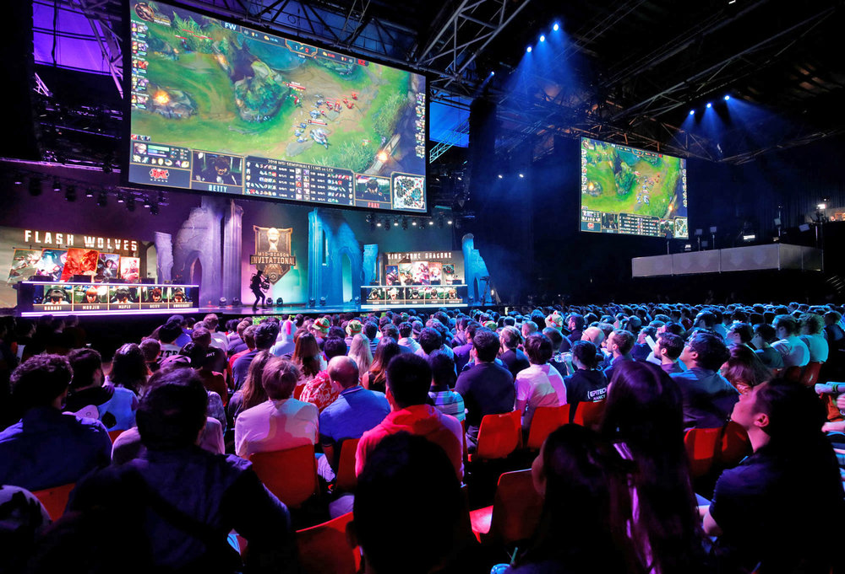
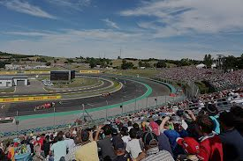



demographic
Motorsport enthusiasts
Motorsport Enthusiasts form the core of the target audience for Trading Paint. The mix of entertainment with adventure will not only get them hooked but would also appeal to a much larger section of viewers. We expect both the new generation as well as the veterans and classic enthusiasts to be attracted to this unique format.
1
3
Influencer audience
Amazon viewership
To keep the non-motorsport fans hooked on to the platform, we have roped in stars, especially the Am class drivers, who will bring in the extra appeal to the show. These Am Class Stars have a larger number of admirers amongst the automotive enthusiasts which will translate into high TRPs.
Trading Paint is based on three key genres – Drama, Documentary & Reality. While the program will pull in the motorsport viewers, the offering will also attract the mass audience beyond sports followers.
2
INTRODUCTION – BUSINESS IDEA – LOCATION – INVESTMENT – DEMOGRAPHIC – MARKETING STRATEGIES – COMPETITOR ANALYSIS – FINANCE

Slide 9

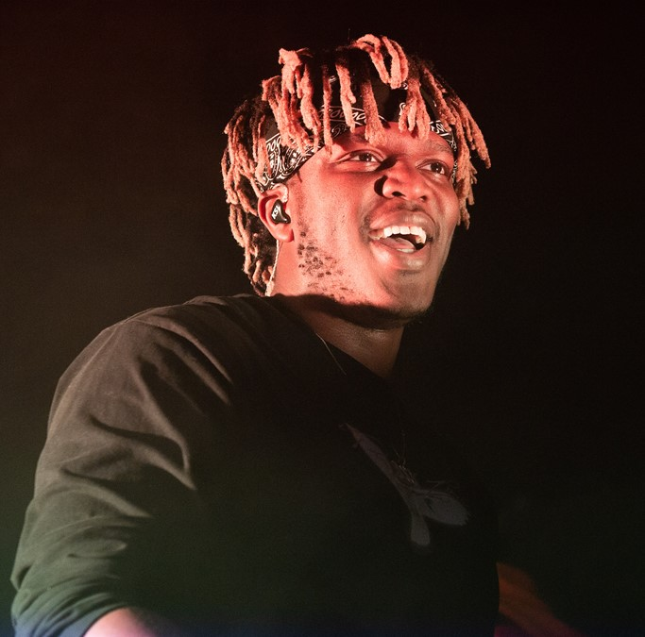
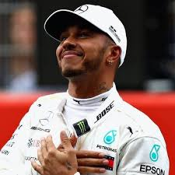
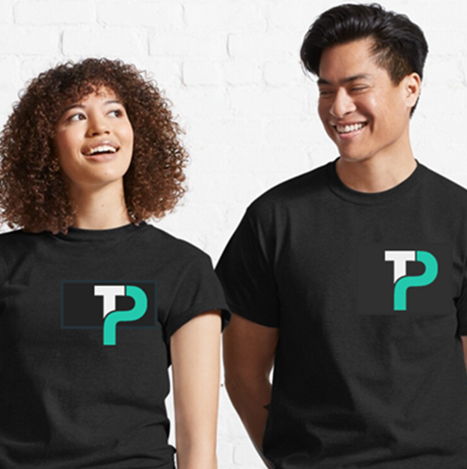
Marketing Strategies
Influencer Marketing
Star guest appearance
Advertising & Merchandising
We will partner with our associates like Amazon Prime Video, Mentors and Am drivers across YouTube, Instagram, Facebook and Twitter.
The twin objective of our marketing strategy would be to a) Attract wide audience and b) To create a brand recall for Trading Paint.
We will be using a targeted approach to achieve a cost-effective campaign.
The social media presence will help us increase the audience engagement by keeping them active and involved both pre- and post-the event.
There will be a combination of an immersive one-day interaction session with the star guest for participants and a visual spectacle for the larger audience. The trivia and experience sharing will enhance the audience interest and provide them to get an insight into the motorsport world.
The engagement with Star guests will not be just promotional but a deeper collaboration where they will be partnering with us thereby giving us the benefit of their aura and star appeal.
We will run select advertisements on specific sports channels and impact SEOs on motorsports-related websites and apps.
We have also tied up with several merchandise partners for fans to indulge. These will include clothing, travel accessories and collector items enhancing the brand visibility and value.
The approach will be to get the fans and influencers to pull in the wider target audience through these select promotions.
INTRODUCTION – BUSINESS IDEA – LOCATION – INVESTMENT – DEMOGRAPHIC – MARKETING STRATEGIES – COMPETITOR ANALYSIS – FINANCE

Slide 10





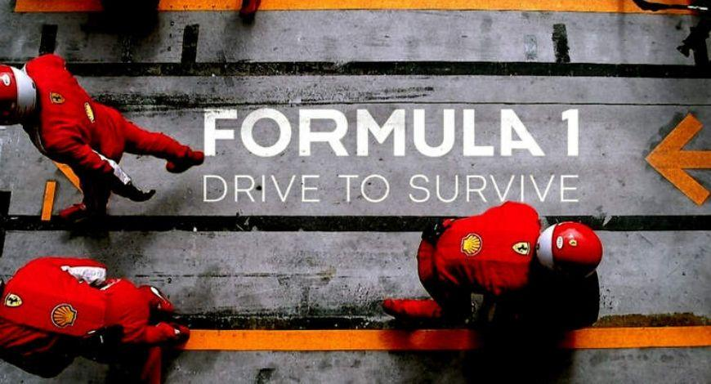

Competitor Analysis
Entertainment: Depicted on the y axis is based on the versatile depiction with a series of exciting features across the episodes.
Novelty: Depicted on the x axis is based ability to innovating with new ideas and themes.
F1 | Grand Tour | X Factor
Britain's Got Talent | The Voice | Drive to Survive
Audience Engagement: Depicted by the bubble size is measured in viewership per dollar spent.
Trading Paint
INTRODUCTION – BUSINESS IDEA – LOCATION – INVESTMENT – DEMOGRAPHIC – MARKETING STRATEGIES – COMPETITOR ANALYSIS – FINANCE

Slide 11

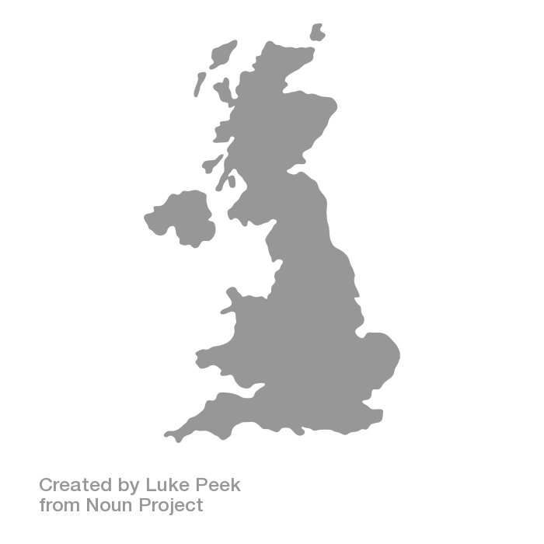




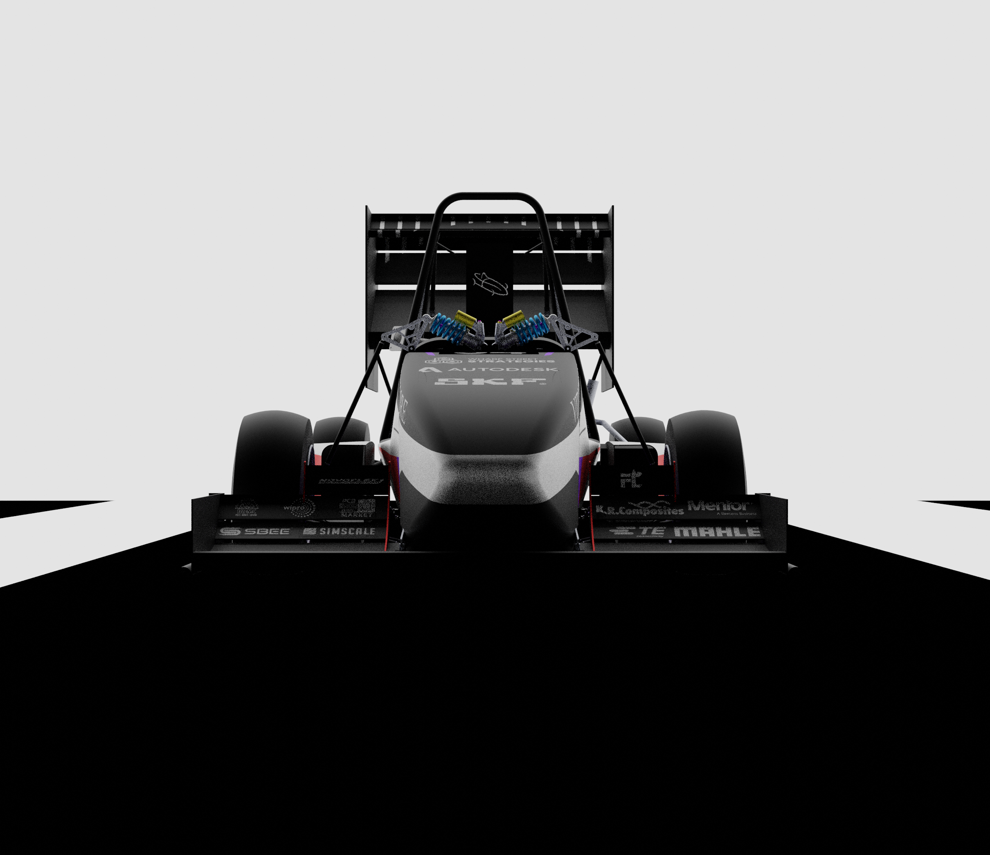


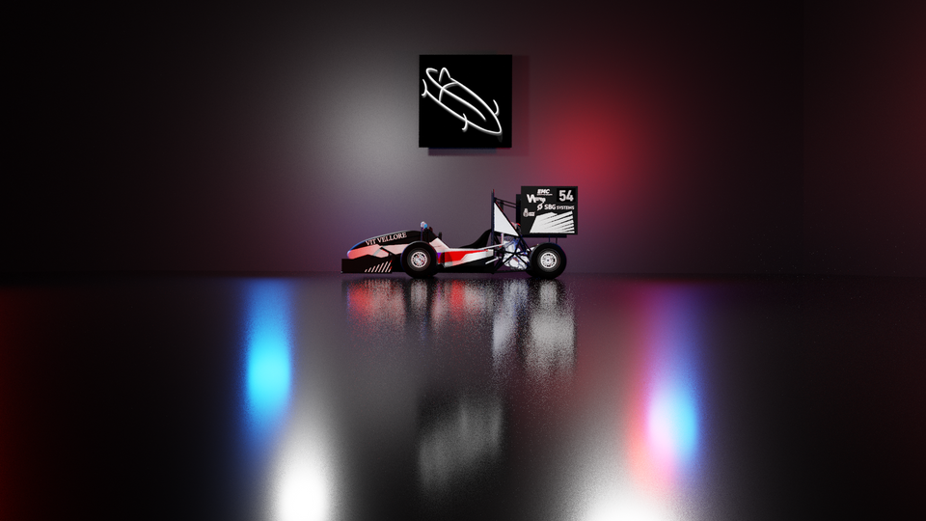

Production
LIGHT WEIGHT
SPACEFRAME CHASSIS
PRODUCTION HOUSE
SINGLE CYLINDER KTM390 ENGINE
SILVERSTONE
2h
2.5h
3h
BRANDS
HATCH
DONNINGTON PARK
HIGH PERFORMANCE
AERO PACKAGE
The 22587 Sq. ft. production facility is strategically located within 3 hours of all the three tracks chosen to host the 10 rounds.
40 engineers will work in this production facility to manufacture 20 racecars for each season.
CFRP WHEEL ASSEMBLY
INTRODUCTION – BUSINESS IDEA – LOCATION – INVESTMENT – DEMOGRAPHIC – MARKETING STRATEGIES – COMPETITOR ANALYSIS – FINANCE

Slide 12



Finances
SOURCES OF REVENUE
PROJECTED BREAK-EVEN POINT
Web Series
Influencer Commission
Ticket Sales
Return on investment
Break-Even is at 10th Quarter
Audience
ROI
50.1%
at the end of
5 Years
Per Year ROI
Cumulative ROI
REVENUE
VIEWERSHIP
EXPENSE+TAX
INTRODUCTION – BUSINESS IDEA – LOCATION – INVESTMENT – DEMOGRAPHIC – MARKETING STRATEGIES – COMPETITOR ANALYSIS – FINANCE

